Slide 1
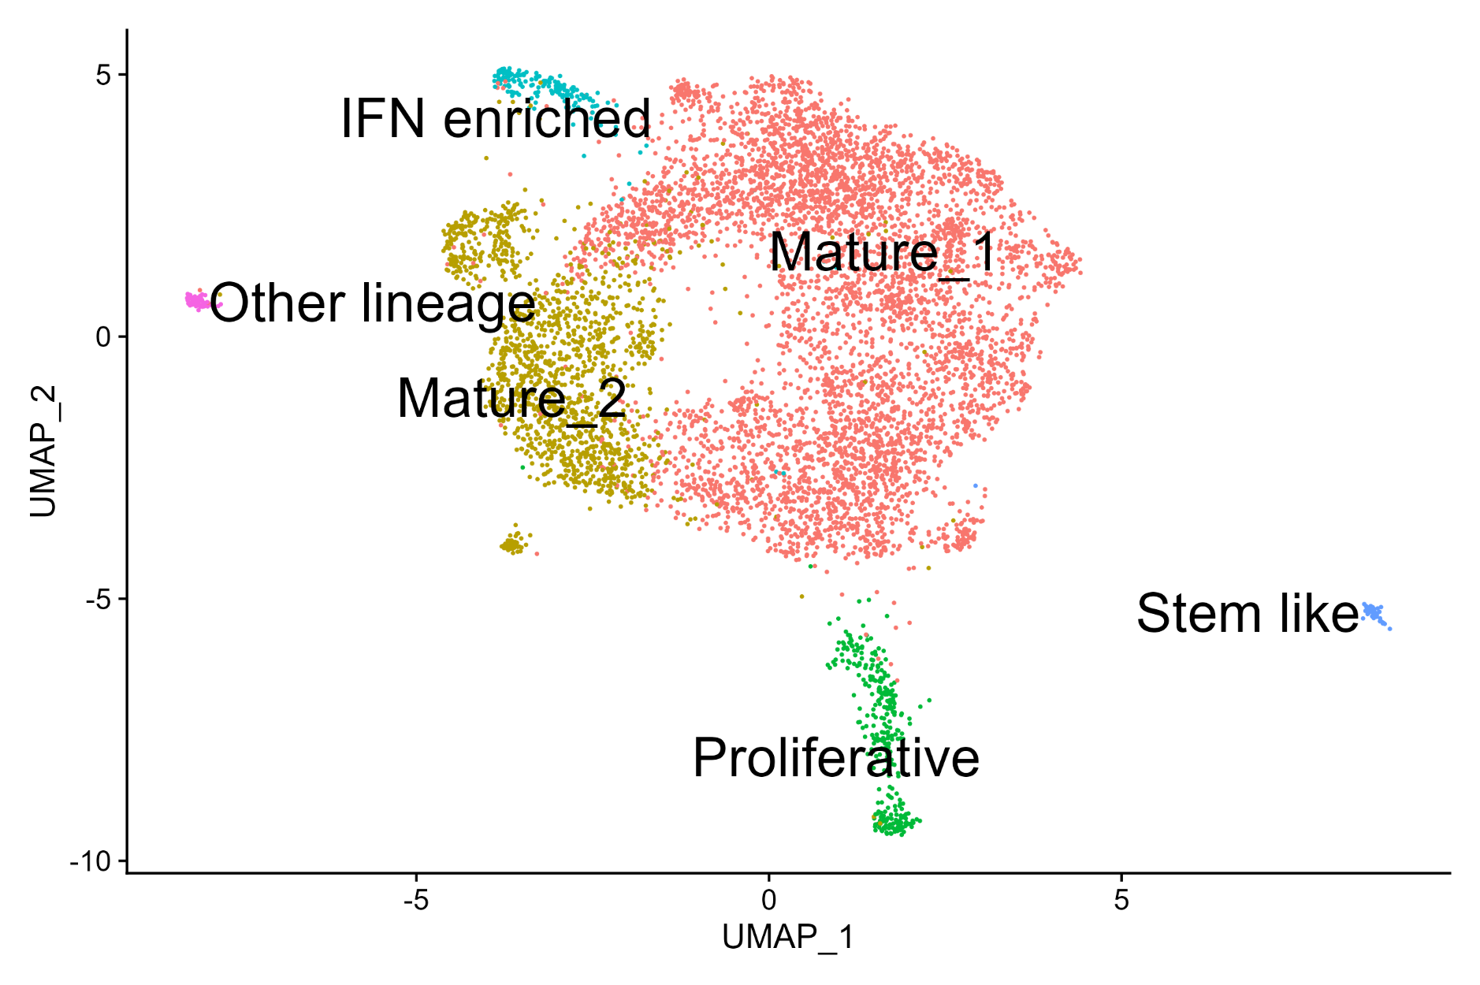
Melanocyte Cell States in the Human Skin
Data taken from GSE151091
Notes:
So based on the cluster markers and their functional enrichment we annotated the clusters as represented. Now because these cells were taken from different individuals representing multiple age groups we wanted to check if these states are present throughout the human life or are they restricted to a particular age group

Slide 2
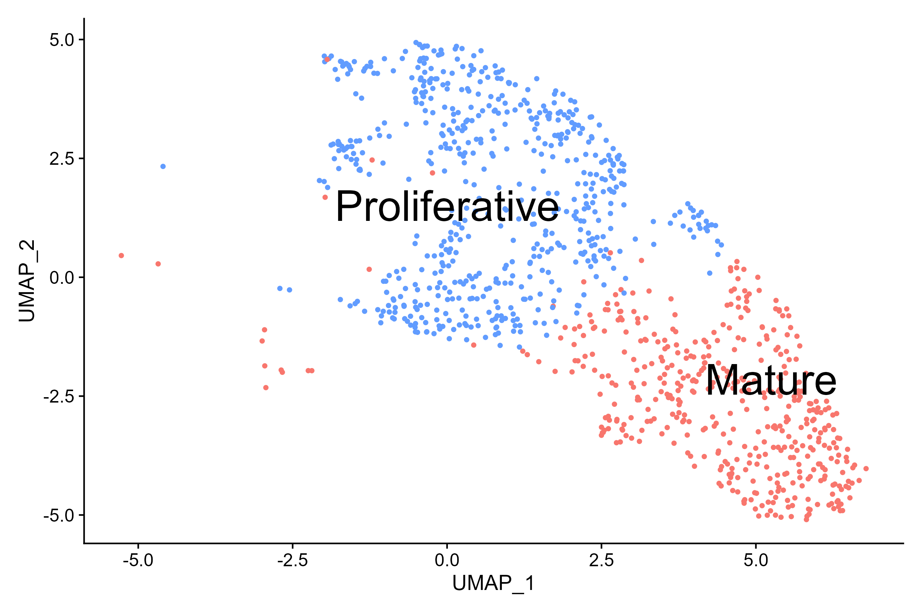
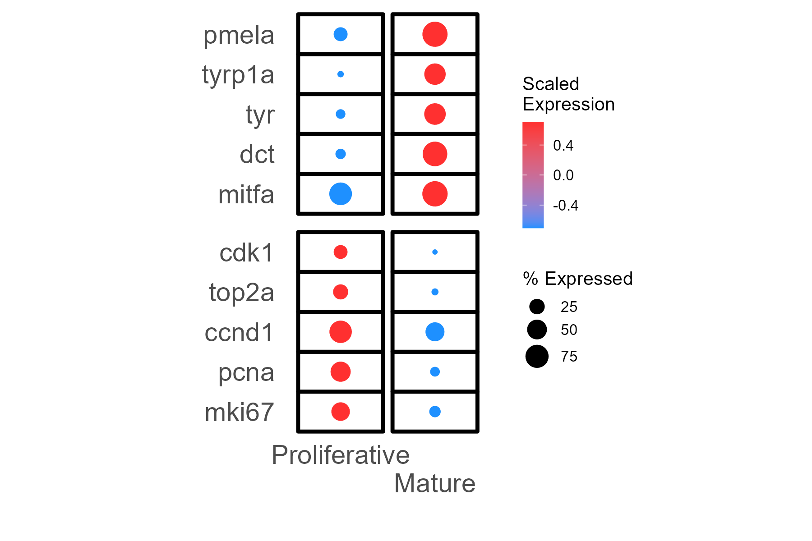
Melanocyte Cell States in Zebrafish

Slide 3
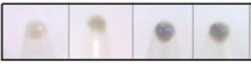
B16 Progressive Pigmentation Model
Seed 100 cells/cm²
Day 0
Terminate Culture
Day 7
Days
Completely Depigmented
Completely Pigmented
Melanocyte State Transitions
It is a cell autonomous, closed system with no external factors.
Temporal resolution allows us to track the cell state dynamics.
Natarajan, V.T. and Ganju, P. et al. PNAS (2014)
Notes:
So for that we selected the B16 Progressive Pigmentation Model system. Now we are well aware of the disadvantages of this system, the biggest one being that it’s a cancer cell line but let me tell you the advantages that it has, the first being that it gives us access to different melanocyte states as evident from the phenotype on different days of the culture. Secondly it does not require addition of any external factors for these transitions to occur and lastly it allows us to track minute changes in the cell states owing to the longer time period of this system. And finally to negate the possibility of our findings being restricted to a cancer system only we always do validation in a primary system as well. Now before we move on to find the drivers of these transitions we needed an easy way to assess these different melanocyte states in this system. Obviously transcriptomics or other omic techniques tell us exactly what we’re asking but they are relatively cumbersome techniques specially when we have a far easier method at least in the case of melanocytes

Slide 4
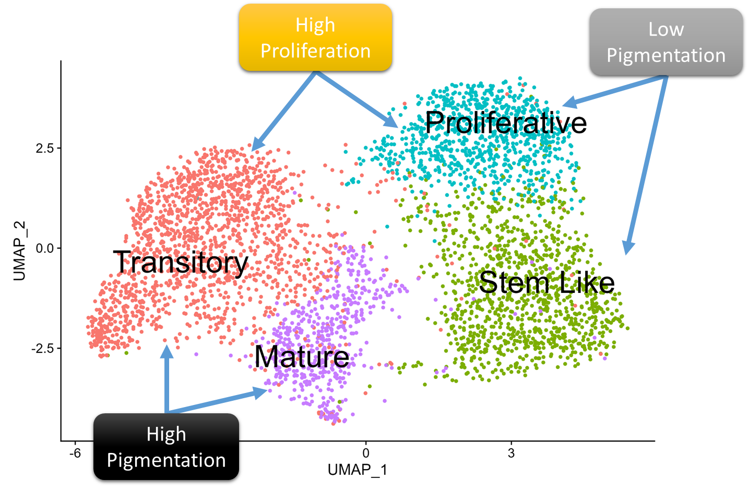
Melanocyte Cell States in Progressive Pigmentation Model
Notes:
You’ll be able to appreciate that there is enough variation in the starting population and when we seeded these cells at low density, we found that all the samples were having similar proportion of high/low pigmented colonies/cells regardless of the starting proportion suggesting that these transitions are in fact happening dynamically and are not predetermined. Subsequently we also looked at the relation between colony pigmentation and size and found a inverse relation between them suggesting that the colonies are probably getting restricted towards a particular fate. To check whether this was actually the case we looked at what was happening inside a colony.

Slide 5
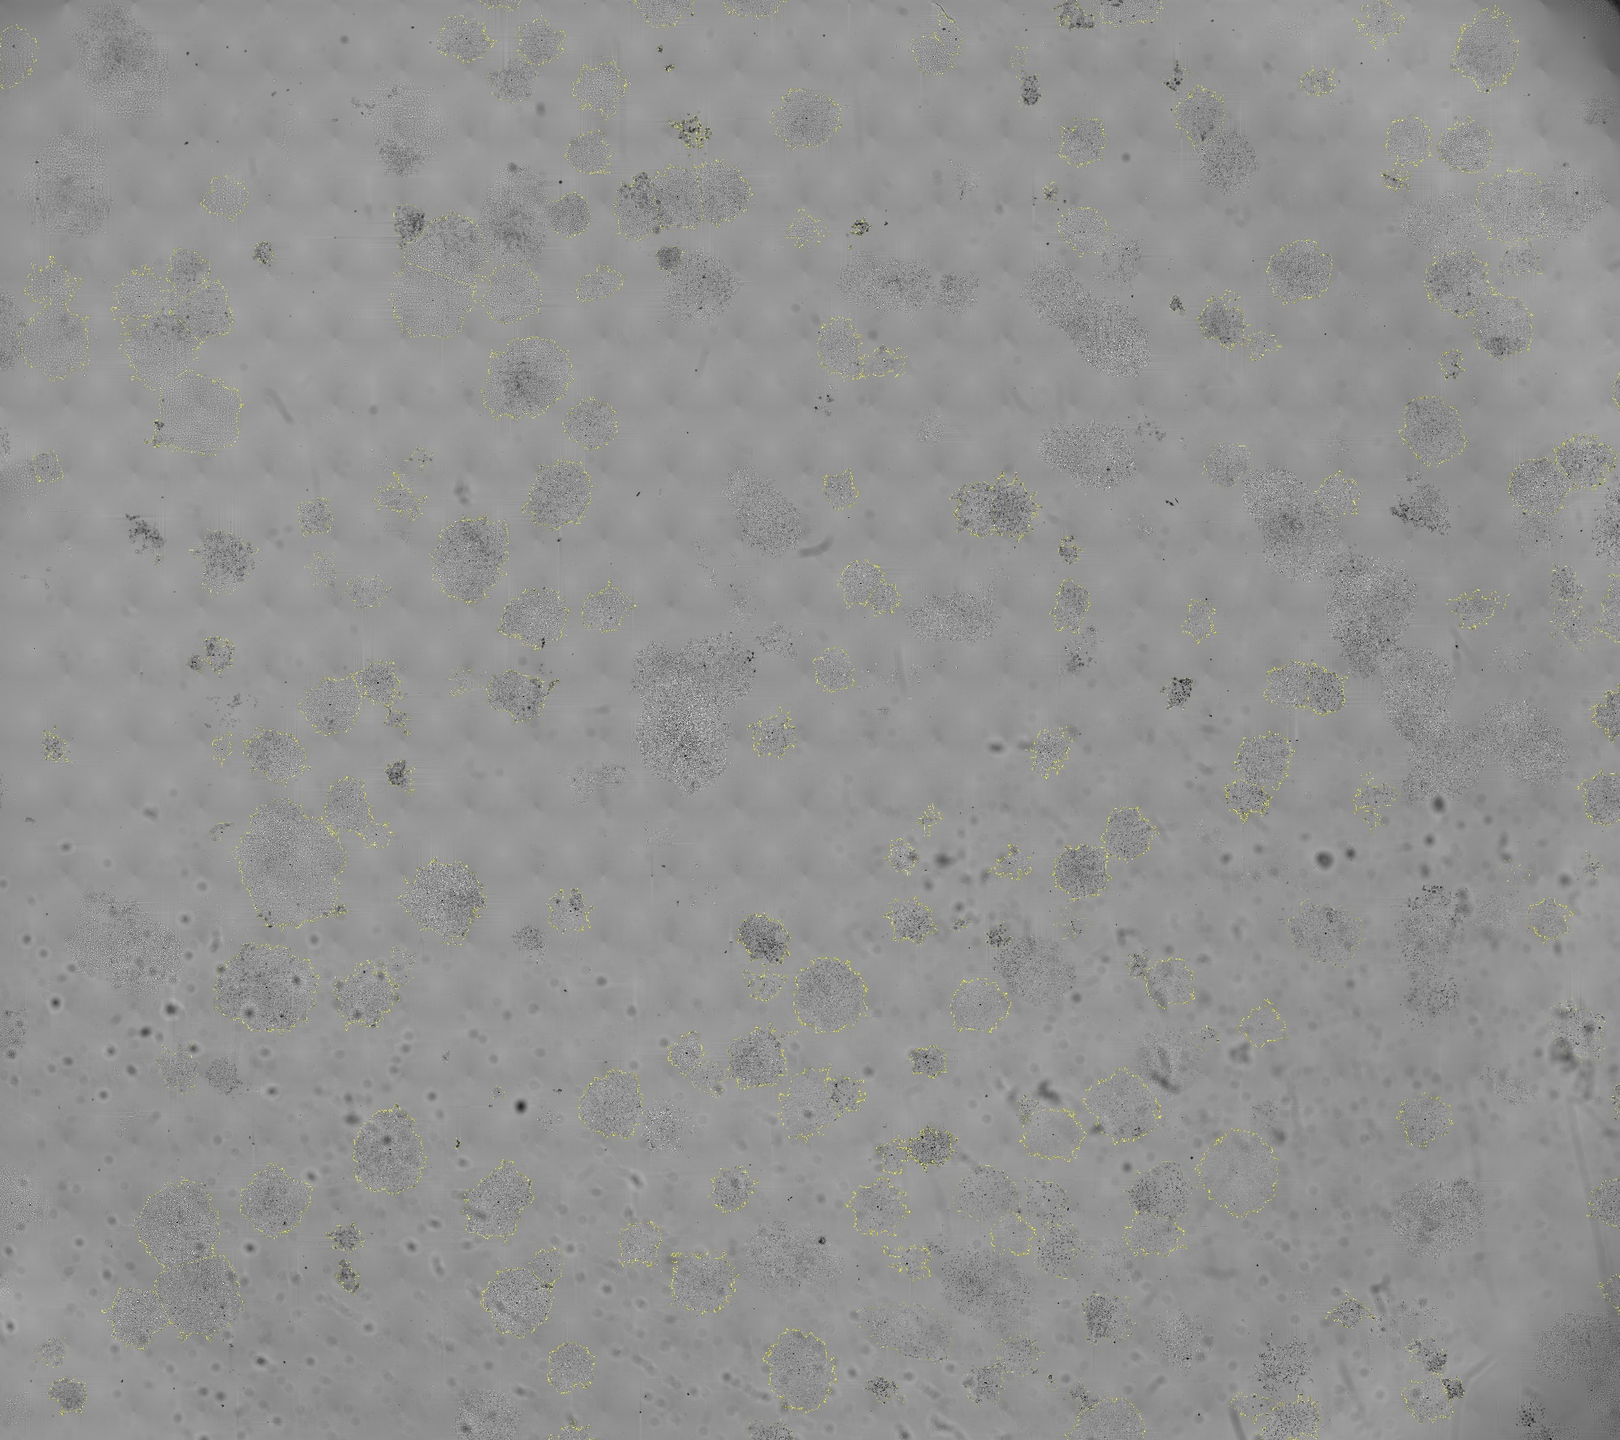
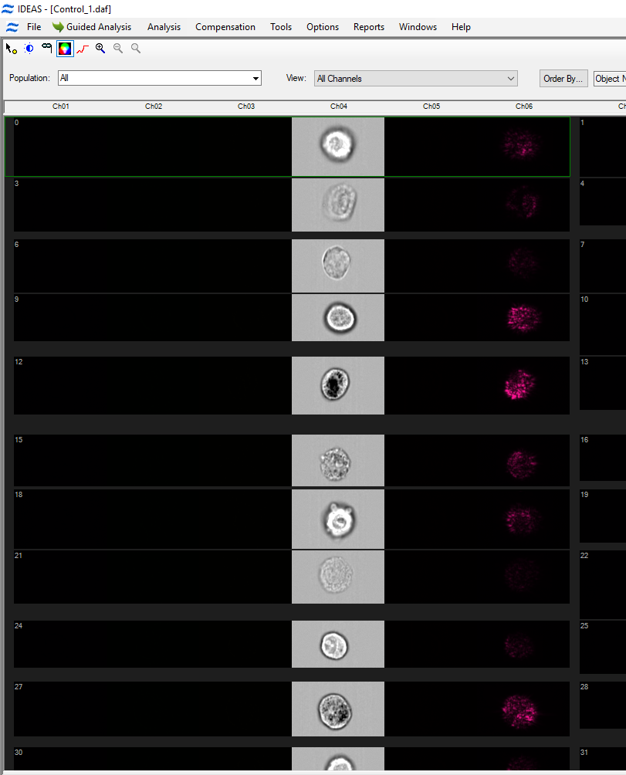
Imaging Assays to Uncover Melanocyte Heterogeneity
High throughput imaging of colonies
Imaging flow cytometry of cells
Notes:
We used high content imaging to capture the colonies at Day7 and imageJ for the analysis and parallelly estimated melanin content in single cells using imaging flow cytometer

Slide 6
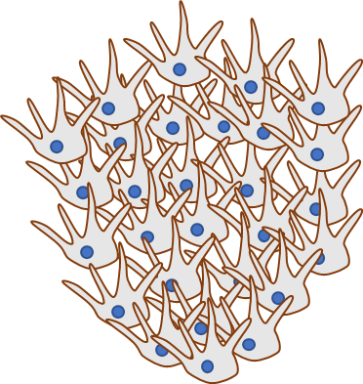



Melanocyte Fate Dichotomy in Progressive Pigmentation Model
Proliferation
Pre-existing differences due to stochasticity in gene expression
Low Density Culturing
Fate
Dichotomy
Pigmentation
Notes:
You’ll be able to appreciate that there is enough variation in the starting population and when we seeded these cells at low density, we found that all the samples were having similar proportion of high/low pigmented colonies/cells regardless of the starting proportion suggesting that these transitions are in fact happening dynamically and are not predetermined. Subsequently we also looked at the relation between colony pigmentation and size and found a inverse relation between them suggesting that the colonies are probably getting restricted towards a particular fate. To check whether this was actually the case we looked at what was happening inside a colony.

Slide 7
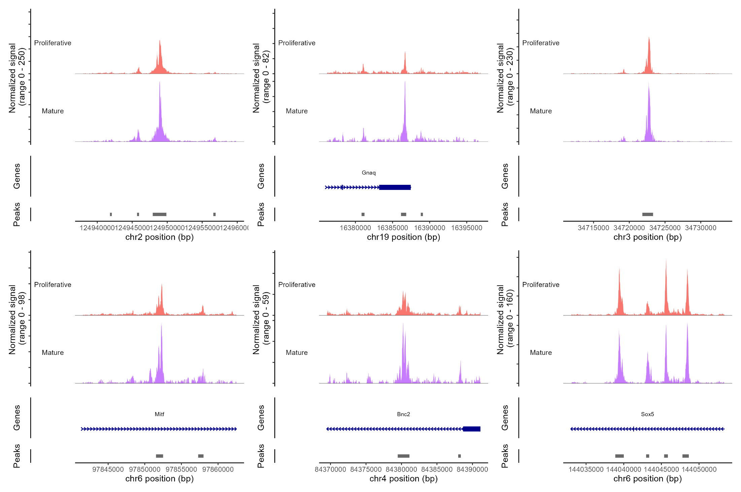
Chromatin accessibility (scATAC)
Proliferative
Mature
Sox2
Gnaq
Slc24a5
Proliferative
Mature
Mitf
Bnc2
Sox5
Notes:
scATAC being very sparse even more so than scRNA data, it is difficult to identify subtle differences. Not able to derive much information just on the basis of ATAC alone

Slide 8
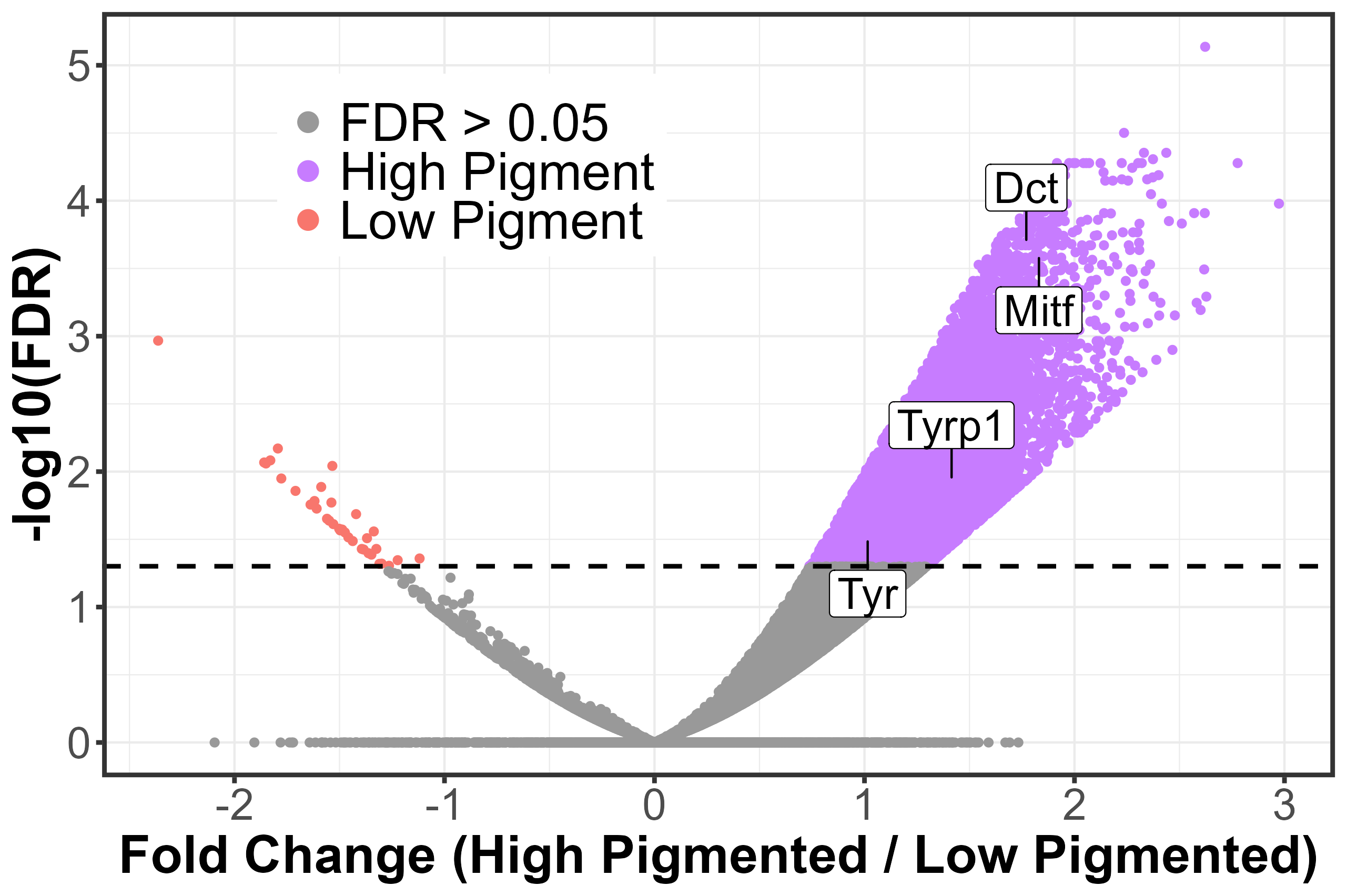
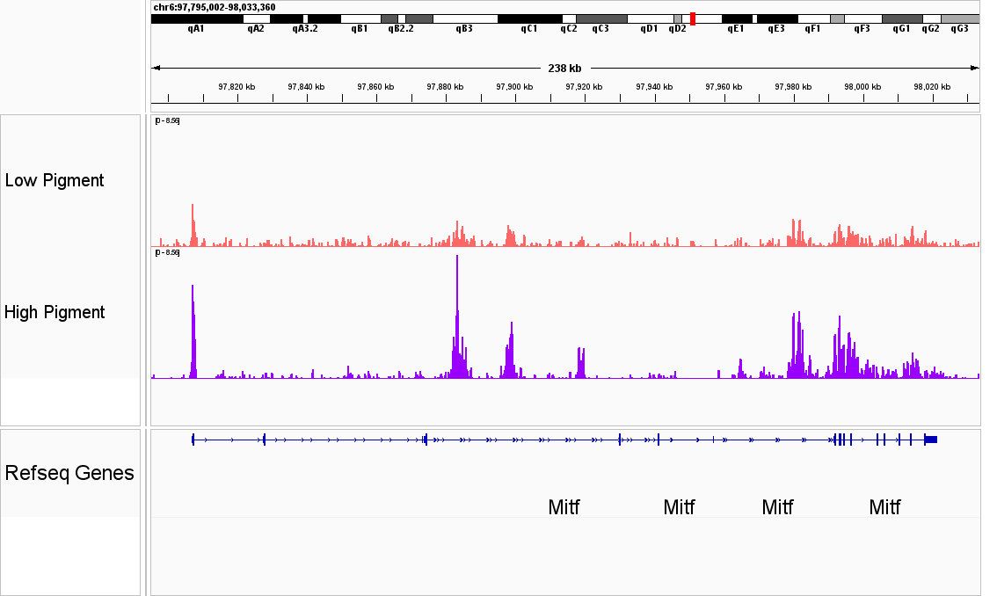
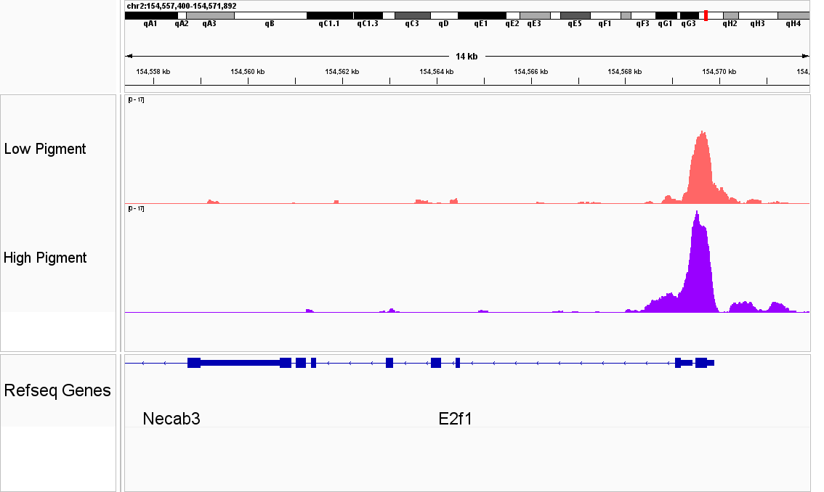
Hyperacetylation at H3K27
Notes:
You’ll be able to appreciate that there is enough variation in the starting population and when we seeded these cells at low density, we found that all the samples were having similar proportion of high/low pigmented colonies/cells regardless of the starting proportion suggesting that these transitions are in fact happening dynamically and are not predetermined. Subsequently we also looked at the relation between colony pigmentation and size and found a inverse relation between them suggesting that the colonies are probably getting restricted towards a particular fate. To check whether this was actually the case we looked at what was happening inside a colony.

Slide 9
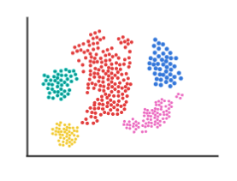
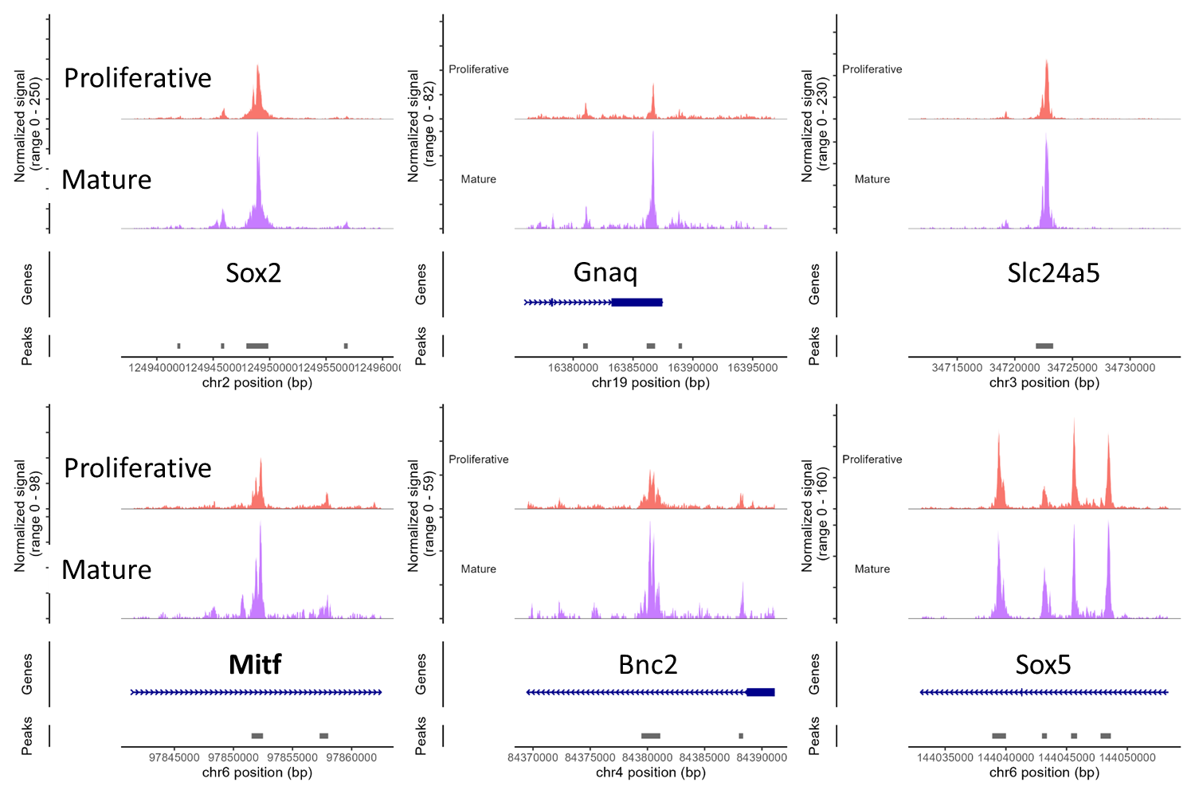



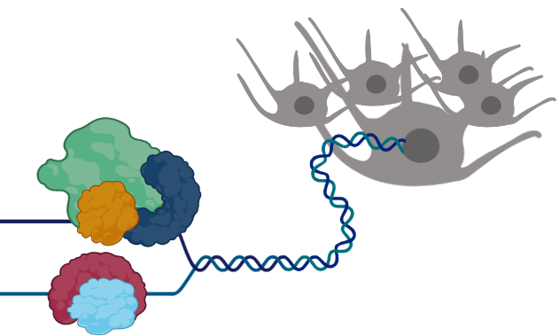
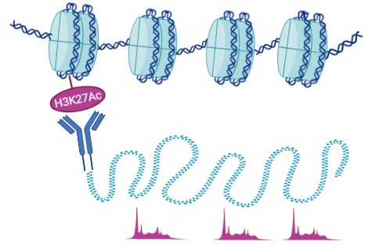
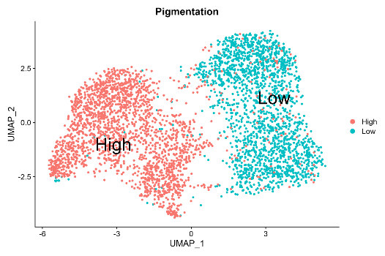
Multi-modal Approach to Identify Melanocyte Cell State Regulators
MOTIF ENRICHMENT FROM DAR
MOTIF ENRICHMENT FROM DHAcR
TF ENRICHMENT FROM TRANSCRIPTIONAL FOOTPRINT AT DAY 7
Schematic by Ayesha
Notes:
You’ll be able to appreciate that there is enough variation in the starting population and when we seeded these cells at low density, we found that all the samples were having similar proportion of high/low pigmented colonies/cells regardless of the starting proportion suggesting that these transitions are in fact happening dynamically and are not predetermined. Subsequently we also looked at the relation between colony pigmentation and size and found a inverse relation between them suggesting that the colonies are probably getting restricted towards a particular fate. To check whether this was actually the case we looked at what was happening inside a colony.

Slide 10
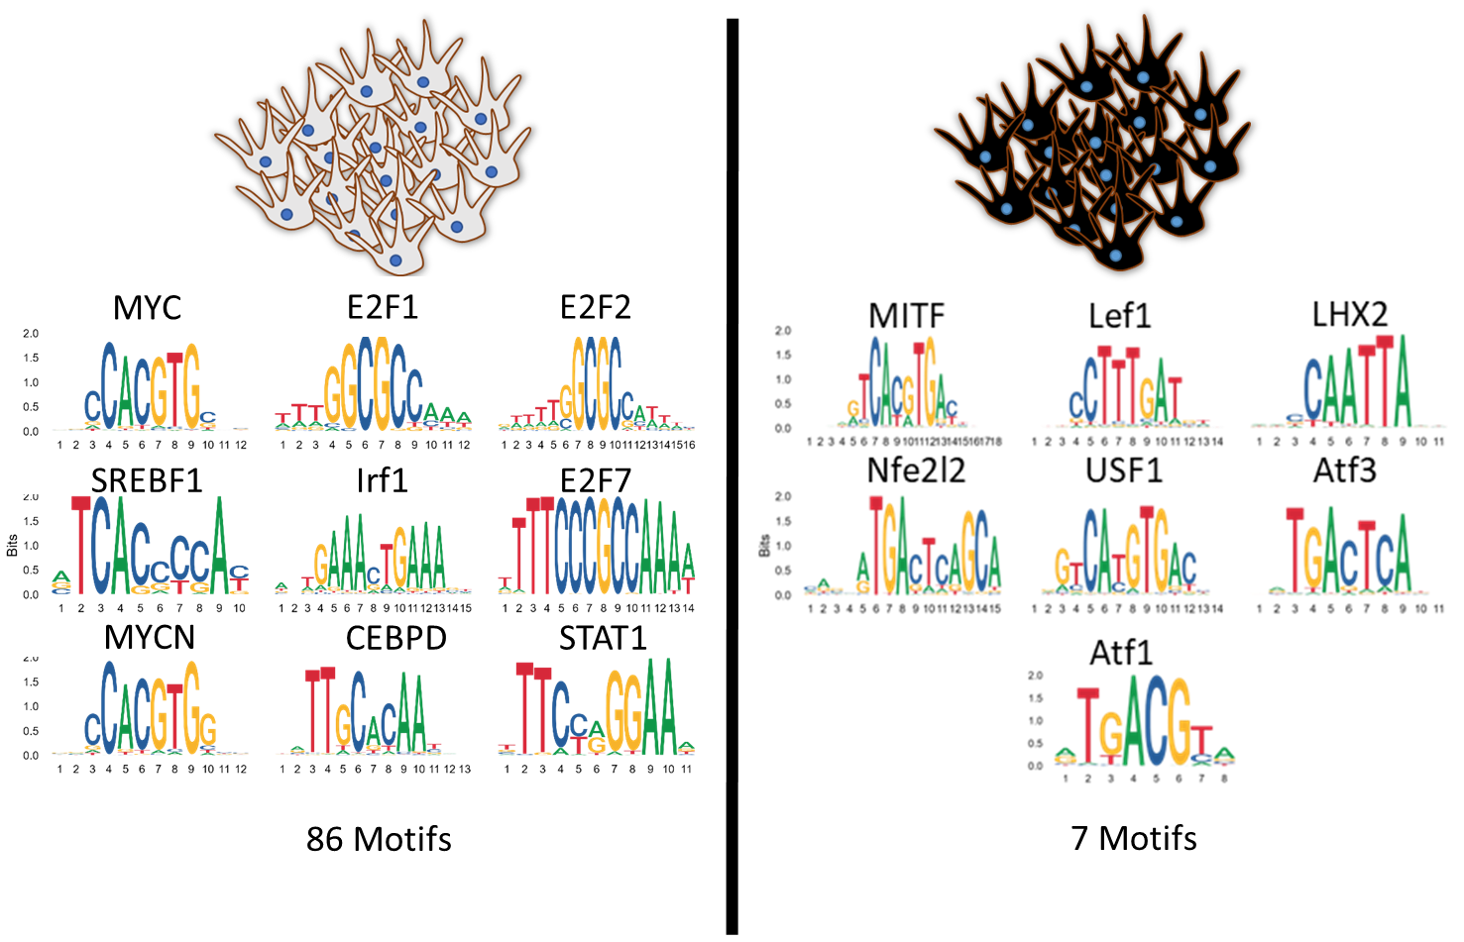
Motifs Enriched in Low and High Pigment States
Notes:
You’ll be able to appreciate that there is enough variation in the starting population and when we seeded these cells at low density, we found that all the samples were having similar proportion of high/low pigmented colonies/cells regardless of the starting proportion suggesting that these transitions are in fact happening dynamically and are not predetermined. Subsequently we also looked at the relation between colony pigmentation and size and found a inverse relation between them suggesting that the colonies are probably getting restricted towards a particular fate. To check whether this was actually the case we looked at what was happening inside a colony.

Slide 11
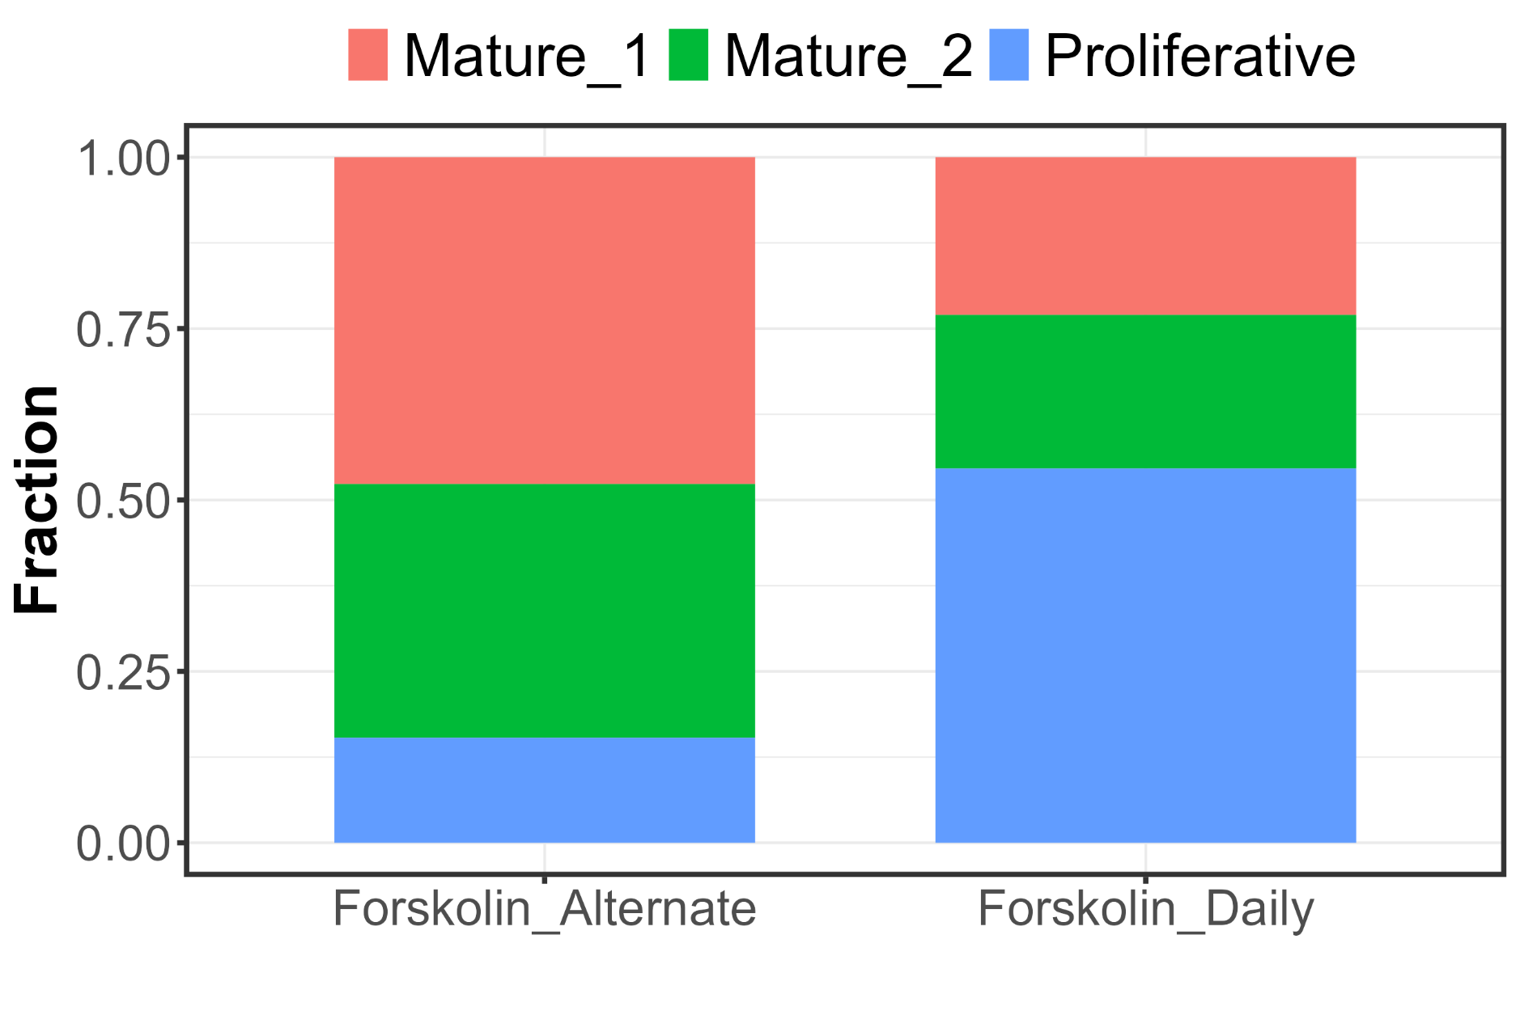
Melanocyte Cell States in cultured NHEM
Notes:
You’ll be able to appreciate that there is enough variation in the starting population and when we seeded these cells at low density, we found that all the samples were having similar proportion of high/low pigmented colonies/cells regardless of the starting proportion suggesting that these transitions are in fact happening dynamically and are not predetermined. Subsequently we also looked at the relation between colony pigmentation and size and found a inverse relation between them suggesting that the colonies are probably getting restricted towards a particular fate. To check whether this was actually the case we looked at what was happening inside a colony.

Slide 12
Proposed Model
Enrichment of
Proliferative State
Low Pigmentation
High Proliferation
Basal Pigmentation
Basal Proliferation
UV
Subsequent trigger
No trigger
High Pigmentation
Low Proliferation
Basal Pigmentation
Basal Proliferation
Enrichment of
Pigmented State
Notes:
You’ll be able to appreciate that there is enough variation in the starting population and when we seeded these cells at low density, we found that all the samples were having similar proportion of high/low pigmented colonies/cells regardless of the starting proportion suggesting that these transitions are in fact happening dynamically and are not predetermined. Subsequently we also looked at the relation between colony pigmentation and size and found a inverse relation between them suggesting that the colonies are probably getting restricted towards a particular fate. To check whether this was actually the case we looked at what was happening inside a colony.

